Slide 1
Budweiser Data Analysis Project
Reed & Miller Consulting
https://www.youtube.com/watch?v=uzc_eJyoHg8
https://youtu.be/nk3bkaz5fKg

Slide 2
Brewery Count By State
Summary statistics
Total breweries counted = 558
Top 10 = ~51% of total count
Top 5 = ~31% of total count
Insight
Sales / growth / ROI initiatives likely aided by focus on top brewery states
Notes:
First up, we are going to look at brewery count by state. As we can see, Colorado has the most breweries at 47. 558 breweries were included in this analysis, with the top 10 states comprising over 50% of all the breweries. This table can be helpful when deciding on new brewery locations, maybe there are benefits to brewing in one of those top 10 states and there could be a reason why there aren’t more breweries in states like Arizona. All things to think about when planning a new brewery

Slide 3
Missing Data / NA’s
Only 2 of 10 categories evidenced missing data / NA’s.
Alcohol by volume of the beer (ABV) = 62 missing values (3% of total)
International Bitterness Units of the beer (IBU) = 1005 missing values (42% of total)
What will be done with this data?
Randomness of NA’s warrants caution in removing all rows with NA’s
NA’s will be removed only when we are analyzing data in the ABV and IBU columns
Otherwise, we are removing valuable data unnecessarily
Notes:
There are some missing values when looking at the beers included in the dataset. The missing values occur in the ABV and IBU columns and were removed when the relevant columns were to be included in calculations. For example, we will be looking at Median ABV by state, so any beers with a missing value for ABV would not be included for that.

Slide 4
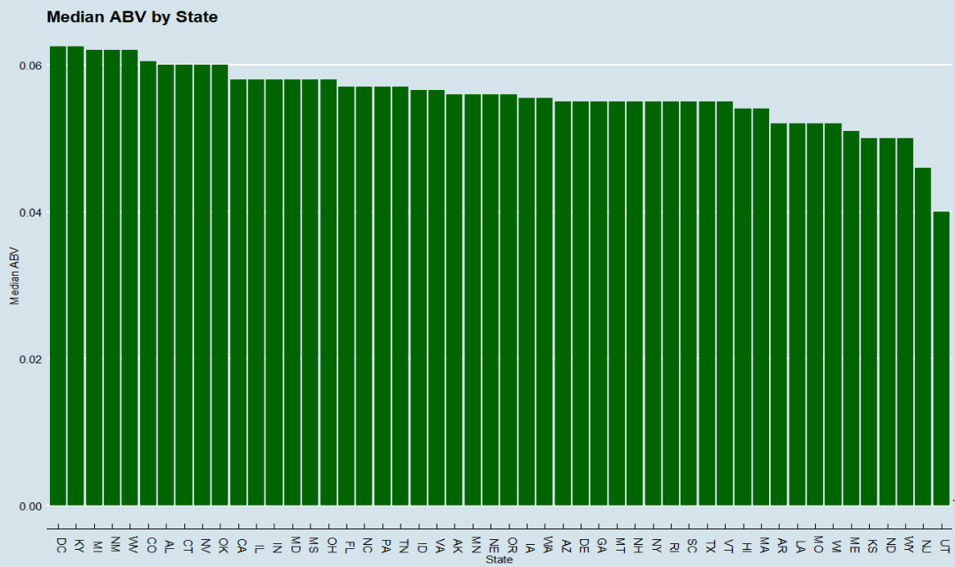
Median Alcohol By Volume (ABV)
Summary statistics
Tight range from 0.04 to 0.0625
Median & mean = 0.056
Insight
Tone it down in Utah

Slide 5
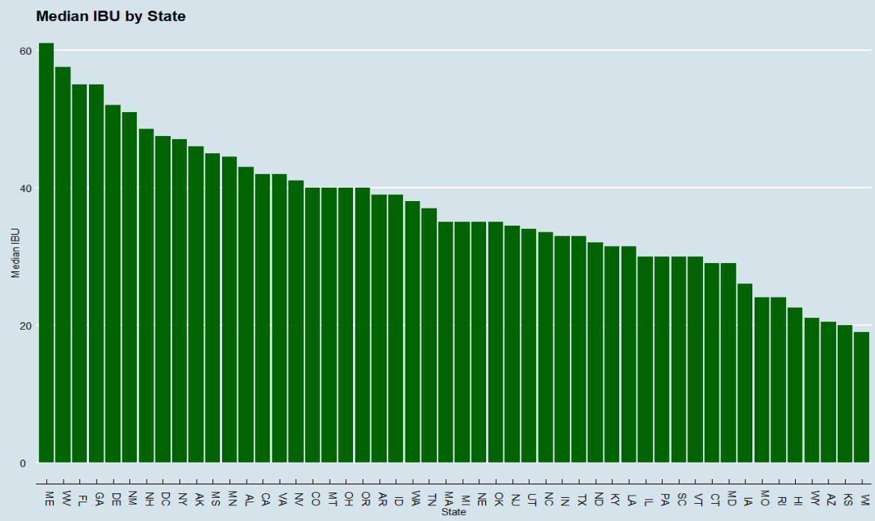
Median International Bitterness Units (IBU)
Summary statistics
Broader range 19 to 61
Median = 37
Mean = 35
Insight
Focus sales efforts on states depending on IBU of the product

Slide 6
Maximum ABV/IBU Beer
The beer with the Highest ABV is the “Lee Hill Series Vol. 5 - Belgian Style Quadrupel Ale”, which comes from a brewery in Colorado and has an ABV of 12.8%.
This suggests that Colorado likes beers with high ABV and looking at the Median ABV by state chart, they have the 6th highest median ABV.
Based on this, it looks like your higher ABV products could do well in Colorado.
The beer with the Highest IBU is the “Bitter Bitch Imperial IPA”, which comes from a brewery in Oregon and has an IBU of 138.

Slide 7

ABV Summary Statistics
As we can see, the mean is relatively close to the median and a 20% trimmed mean.
This tells us that there are not a significant number of outliers and/or they are not very extreme.
This also suggests that when you are creating new beers, you should try to stay relatively within the norm (about 4-10% ABV).

Slide 8
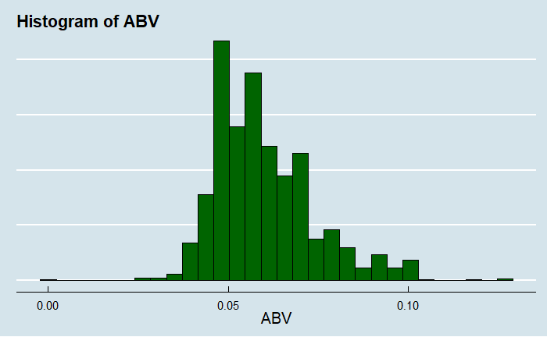
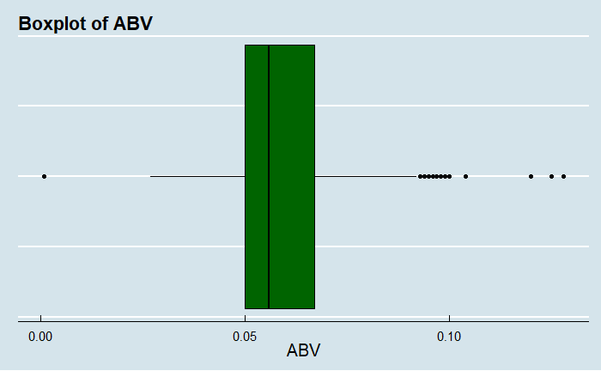
ABV Distribution
The histogram and boxplot appear slightly right skewed. This indicates there is a group of beers that have a higher-than-normal ABV.
The boxplot shows these outliers, and they tend to be IPAs as one would expect.
In the 4th quartile of the boxplot, 50.7% of the beers are IPAs, while IPAs only make up 23.8% of all beers in this study.

Slide 9
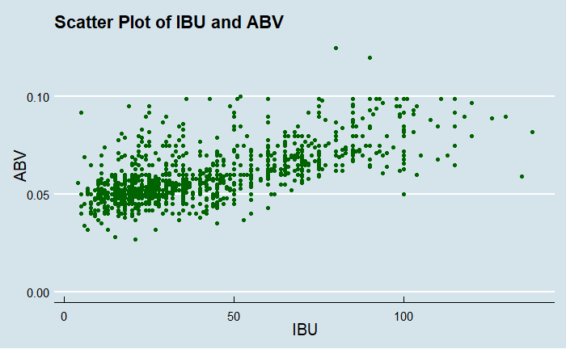
IBU/ABV Correlation
The graph shows a positive correlation between the two variables.
The Pearson Correlation Coefficient is .67 which also indicates a strong positive relationship between ABV and IBU.
It appears that as a beer increases on International Bitterness Units (IBU) scale, the Alcohol by Volume (ABV) also increases in a linear fashion.
When the bitterness (IBU) is increased by increasing the amount or changing the timing of the hops, more sugar is added in the fermentation process to compensate, which increases the ABV.
This is useful because if you want to create a more bitter beer, you know to increase the ABV as well from looking at your competitors.

Slide 10
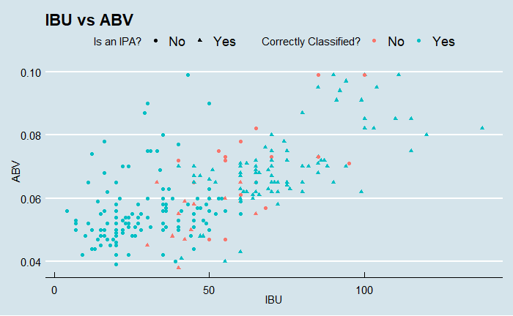
IBU/ABV KNN Classification
Using KNN, k= 14, the model correctly identified between IPA and non-IPA ales correctly 87.3% of the time.
For each ale, KNN uses the closest 14 ales on the graph to determine whether it is an IPA or not.
If 8 of the 14 closest ales on the graph are IPAs, then that ale would be identified as an IPA since that is more than 50%.
This confirms there is a strong relationship between an ale’s IBU/ABV and IPAs tend to have a higher values for both, as we can see on the chart.

Slide 11
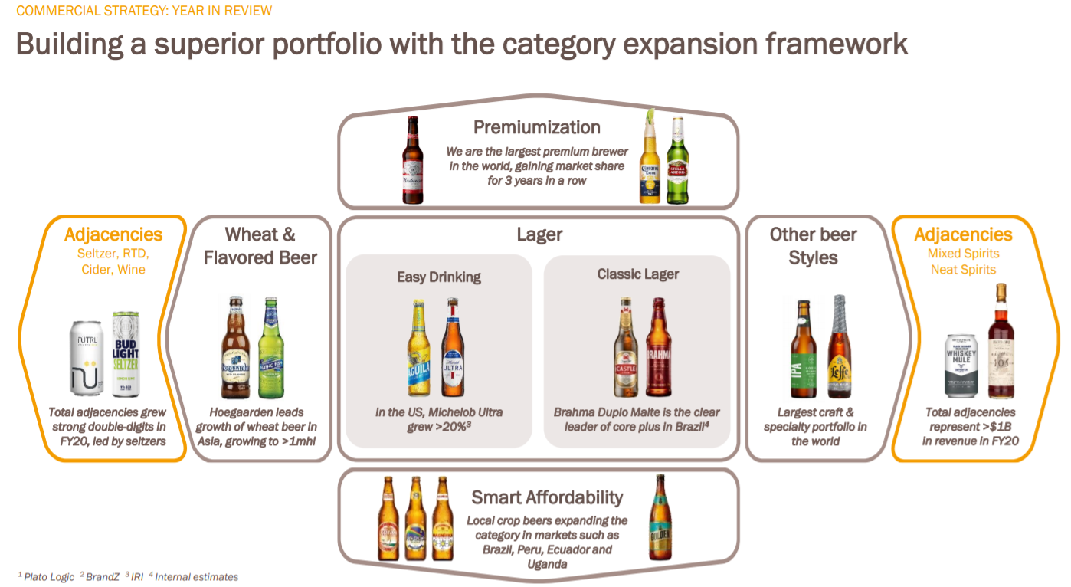
Insight – Where to Focus Sales Penetration?

Slide 12
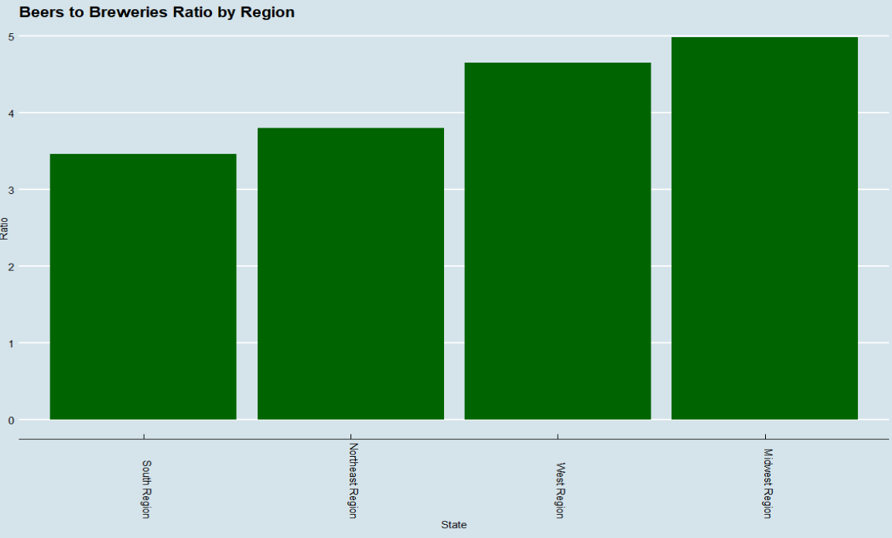
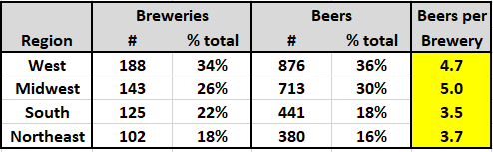
Where to focus by Region
Question
Which region should you focus your efforts to penetrate further?
Recommendation
South Region
Lowest Beers per Brewery Ratio
Favorable demographic trends

Slide 13
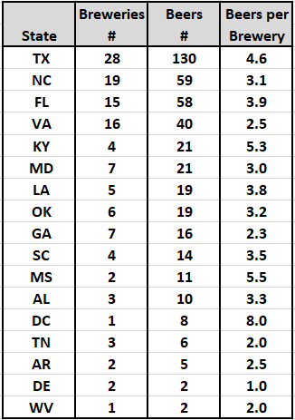
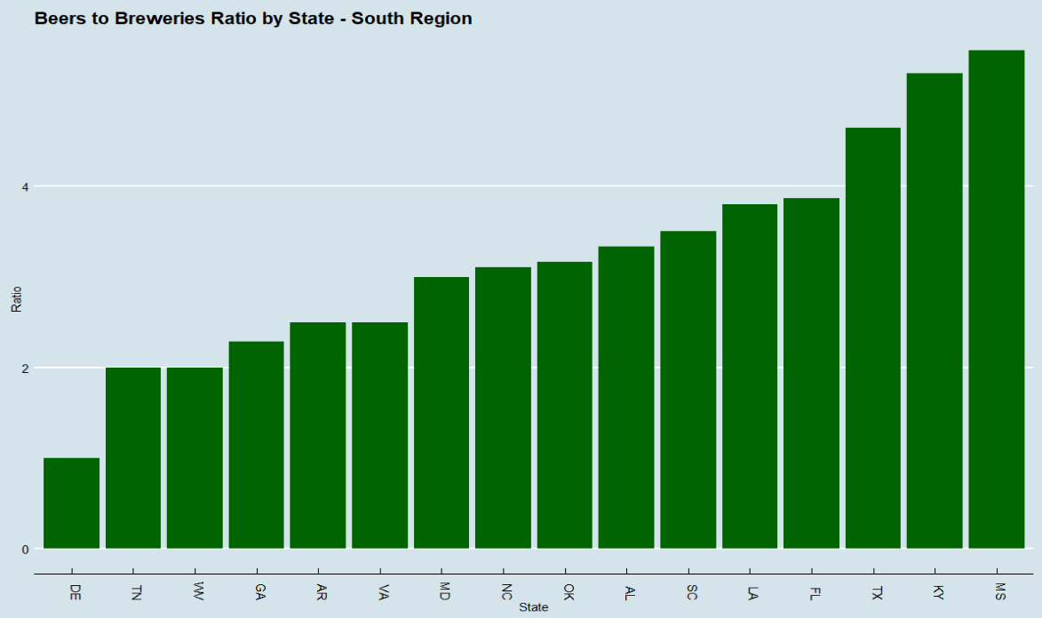
Where to focus by State in South Region
Question
Which states should you prioritize in the South Region?
Recommendation
North Carolina and Virginia at first

Slide 14
Q&A
Thank you for your time and business

